Slide 1


Q3, 2020
Welcome to NOTE AB (publ) – Q3 presentation 2020-10-19

Slide 2
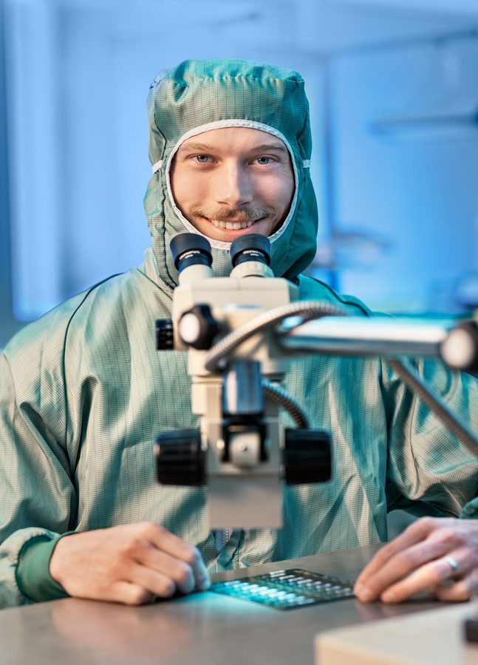
Strong progress for NOTE YTD 2020
Sales +10% to 1 408 (1 277) MSEK.
Operating Profit +25% to 111 (89) MSEK.
OP-margin +0.9%-points to 7.9% (7.0%).
Profit after financial items +25% to 103 (83) MSEK.
Profit after tax +27% to 84 (66) MSEK, or SEK 2.99 (2.37) per share.
Cash flow after capex +128 (-21) MSEK, or SEK
+4.51 (-0.75) per share.

Slide 3

Q3 – Positive profit performance despite lower tempo across industry
Sales 433 (434) MSEK, currency adjusted organic growth +3%.
Order backlog up ~10% vs LY.
Operating Profit +14% to 36 (32) MSEK.
OP-margin +1.0%-points to 8.3% (7.3%).
Profit after financial items +15% to 33 (30) MSEK.
Profit after tax +27% to 28 (22) MSEK, or SEK 0.98 (0.81) per share.
Cash flow after capex +1 (+1) MSEK, or SEK +0.04 (+0.04) per share.
Equity ratio 45% (39%).

Slide 4



Western Europe Operating Margin 9.7%, Rest-of-World 4.7%
Sweden
Finland
UK
Estonia
China
NOTE MANUFACTURING UNIT
Western Europe – sites in Sweden, Finland, and UK
Rest-of-World – sites in Estonia and China

Slide 5
Strong sales growth in Medtech and Industrial segments (MSEK)
Jan-Sep 2019 Jan-Sep 2020
Industrial segment (growth +12%) still largest. Communication (-12%), Medtech (+64%), Defence (-25%) and High-end consumer (+19%)

Slide 6
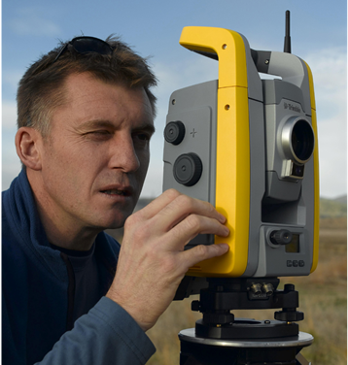

Operational highlights Jan-Sep 2020
Quality and delivery performance, possibly “best-in-class”
Record high wins within existing customer base and with new customers
  Biggest-ever wins secured
    Med-tech win, now in serial production
    Industrial win, currently in NPI phase
  Strong organic growth in several relatively new co-operations, including Plejd, Charge-Amps, Maven Wireless, Hövding, DeLaval
Overall continued robust progress in Sweden, Finland and Estonia
Extensive closures across the UK economy limiting our overall growth in Western Europe to 16%
Global trade tariffs and covid-19 restrictions reducing output in China
  Estimated covid-19 sales impact YTD in UK/China appr. 50-100 MSEK

Slide 7

Operational highlights Jan-Sep 2020, cont’d
Increased Capex level to support further growth
  Clean room capacity in Norrtelje doubled
  Significant expansion (~50%) of Torsby capacity in 2021
Return on Operating Capital – ROOC ~21% – and above financial target
Cash flow last 12 months 224 MSEK, or 7,89 SEK/share
Strong balance sheet – Equity ratio 45%, record high liquidity, low net debt

Slide 8
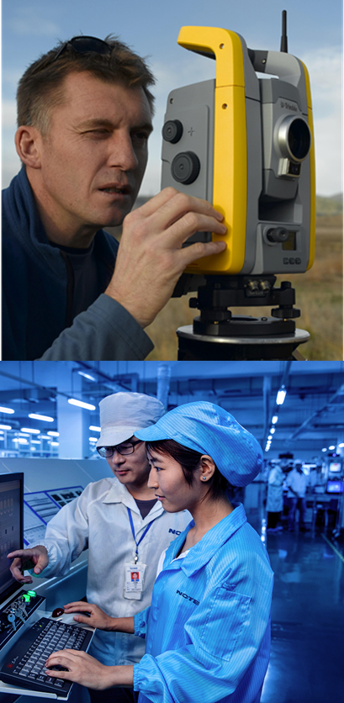
Q4 expectations
All plants in Europe and Asia in operational mode (covid-19)
  Still limited capacity in the UK
Positive trend of winning new customers and projects expected to continue – currently strong operational momentum
Many projects still in ramp-up phase
  Joint development and start-up projects being delayed in current market situation – covid-19 restrictions
  As in Q3, further inventory adjustments from customers likely to impact short term sales
Going forward, good potential to increase market shares and to continue the positive growth and earnings trend (EBIT/EBIT%)
Strong financial position – high emphasis on exploring new attractive growth opportunities in turbulent market situation

Slide 9
Profitability improvement through sales growth and cost efficiency
NOTE – Growing with increased profitability since 2014…
Sales growth since Q4, 2013. CAGR >12%
Sales 2019: 1 760 MSEK. Growth 28%, whereof organic 17%
Sales YTD 2020: 1 408 MSEK. Organic growth 10%
Continued Margin strengthening since 2013.
Operating Margin 2019: 7.1%, +0.5%-points
Operating Margin YTD 2020: 7.9%, +0.9%-points
* OP (EBIT) adjusted -16 MSEK for non-recurring profit
in Q1, 2017, and +7 MSEK for EO cost in Q3, 2018
9

Slide 10
Thank you!

